Slide 1
Research Methodology Module 4 Research Communication
Notes:
This PPT template was created to assist in the creation of engineering feature TOIs. The audience is primarily VERITAS Technical Support, however other consumers include pre-sales System Engineers, consultants, and VERITAS Education and Enablement Services (VEES).

Slide 2
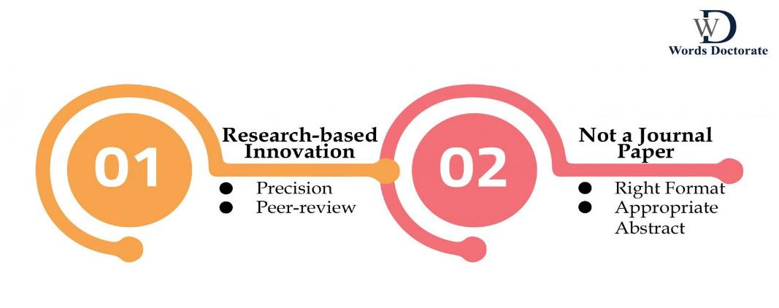
Writing a Conference Paper
to understand that conference papers are meant to get presented in front of a highly knowledgeable audience. This audience is well aware of the subject, yet looks forward to gaining added information or an innovative idea to enhance the current subject. To write a conference paper there are some key principles that you need to.

Slide 3
To Write a Conference Paper with Innovation
To write a conference you must understand the purpose, the discipline, and the format of the paper. Unlike any other research paper, a conference paper remains concise and absolute about the new idea or any innovative plan. You need to consider some brainstorming sessions for yourself to resolve a particular problem to build a new way of looking at a particular issue. While doing so, you must express your in-depth understanding and knowledge about the subject in a very precise manner. Moreover, it is also necessary that the audience that comprises your peers get the encouragement to evaluate your paper.
To gain an answer to how to write a conference paper?’
always remain focused on enhancing your innovative research approach, and express the same by following the steps as noted below:
Deal with a Common Topic -> Identify the Challenge/s -> Undergo Voracious Readings -> Brainstorm Yourself -> Find Solution/s to the Identified Challenge/s
By means of offering a unique and effective solution to your conference paper, you can add great relevance to the subject and this is something that gets highly acknowledged by scholars.

Slide 4
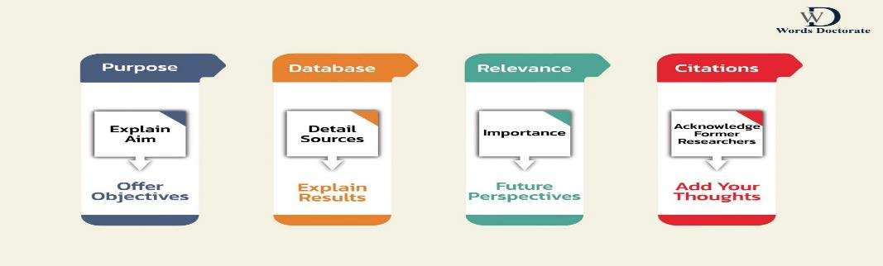
Write a Conference Paper with Precision
For a conference paper always create a draft. Try to construct the information around it. Avoid all kinds of repetitions and unnecessary information. Do not ever include any word or sentence that is irrelevant to the topic.
Your Introduction should be constructed as per the interest of the audience. There is no need for any reference to former research work. You are not supposed to elaborate on the ways you have attained the results. Just stay focused in explaining the Results that you have attained from your experiment. Conclude the conference paper with affirmations and possibilities for future research.
Write a conference paper by addressing the following aspects in a very precise and comprehensive manner:

Slide 5
Write a Conference Paper for Peer-review
Since the conference paper gets presented to scholars, make sure that you maintain complete professionalism while making the presentation. There should be an adequate amount of clarity in your language and a comprehensive way of presenting every justification. When you write a conference paper, remain specific about supporting your logical sentences with in-text citations. Always explain the reasons to either support or reject the particular thought of the former researcher. Enlist the sources of the in-text citation in the Reference List.
While explaining your research context use transitional phrases, such as-
‘therefore’, ‘hence’, ‘consequently’, ‘moreover’, ‘meanwhile’, ‘however’, ‘therefore’.
Always prefer to address the systematic mode of explanation in a very step-by-step manner. Always use ordinals and signpost phrases, such as –
‘firstly’, secondly’, ‘next’, 'This essay critically examines', ‘The major issue…’, 'This essay is organised ...'.
Open debates for discussions and remain ready for feedbacks and rejections from your peers. If you are getting a notable amount of critical points of view, then consider your conference paper as a success. Gaining the attention of your peers adds relevance and significance to your conference paper. Always welcome and appreciate their ideologies and school of thinking.

Slide 6
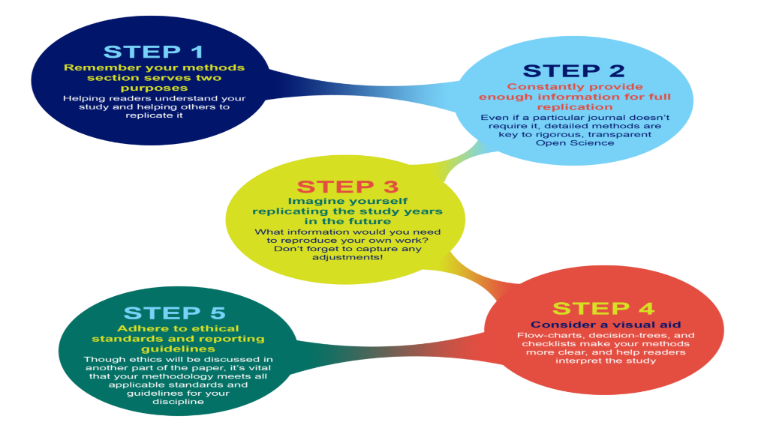
Writing a Journal paper

Slide 7
Writing a Technical report
What is a Technical Report? (Definition):
A technical report is described as a written scientific document that conveys information about technical research in an objective and fact-based manner. This technical report consists of the three key features of a research i.e process, progress, and results associated with it.
Some common areas in which technical reports are used are agriculture, engineering, physical, and biomedical science. So, such complicated information must be conveyed by a report that is easily readable and efficient.
Similarly, before writing a technical report, you must keep in mind who your reader is going to be.
Whether it is professors, industry professionals, or even customers looking to buy your project – studying the target audience enables you to start structuring your report. It gives you an idea of the existing knowledge level of the reader and how much information you need to put in the report.
Step 1: Understand the Purpose and Audience
Step 2: Gather and Organize Information
Step 3: Write the Introduction
Step 4: Describe the Methodology
Step 5: Present the Results
Step 6: Discuss the Findings
Step 7: Conclude and Recommend

Slide 8

dissertation/thesis writing.

Slide 9
7 steps to writing a dissertation/thesis
Choose your topic wisely
Check what's required of you
Conduct in-depth research
Develop a strong thesis statement
Proofread and edit
Seek feedback and finalise
Submit

Slide 10
Presentation techniques
Plan your presentation
Know your audience
Presentation outline
Keep it simple
Storytelling
Visual aids
Clear call-to-action
Q & A session
Improvise
Practice

Slide 11
software used for report writing such as WORD, Latex etc.
1. LaTeX is a high-quality typesetting system; it includes features designed for the production of technical and scientific documentation. LaTeX is the de facto standard for the communication and publication of scientific documents. LaTeX is available as free software.
2. LATEX is an extremely powerful markup language for creating structured documents. It is particularly well suited for documents containing mathematics, but can be used for any document. Those whose publications involve a large number of mathematical equations often use LATEX rather than MS Word or some other word processing package. It is the standard writing tool for most research in the mathematical, physical and engineering sciences.
3. Latex provides a facility for pdf output so that it is easy to share your research with other people who do not have LATEX installed. Remarkably, LATEX is freeware. LATEX is widely used in academia for the communication and publication of scientific documents in many fields, including mathematics, statistics, computer science, engineering, chemistry, physics, economics, quantitative psychology, philosophy, and political science etc.
4. Latex, which is a high quality typesetting software, is extensively used for preparing technical and scientific articles. Though Latex has a learning curve, compared to other word processors, it offers several benefits such as typesetting journal articles, reports and books with professional quality, control over large documents that contain sections, figures and tables.
5. LaTeX allows authors to focus on the content of what they are writing and the LaTeX system will take care of its visual appearance like formatting, layout etc.
Hence,it provide a clear understanding of the basics of technical writing which will enable the participants to communicate their ideas effectively in the form of technical reports, journal papers etc. using the technical writing tool LATEX.

Slide 12
Types of journal/conference papers
There are many types of journal and conference papers, including:
Abstract: A short summary of your research, usually 250 words or less.
Extended abstract: A high-level summary of your research, usually less than 2 pages.
Full paper: A complete paper that describes your research in full, usually 6-8 pages long.
Research poster: A poster that can be 1-2 pages long.
Research-in-progress presentation: A presentation that can be 3-10 pages long.
Original article: A type of journal manuscript.
Review article: A type of journal manuscript.
Case report: A type of journal manuscript.
Case study: A type of journal manuscript.
Editorial note: A type of journal manuscript.
Short communication: A type of journal manuscript.
Example: Types of IEEE Conference Papers
Abstract: Synopsis of your research (250 words or less)
Extended abstract: High-level summary of your research (less than 2 pages)
Brief or short paper: Summary of your research (less than 4 pages)
Full paper: Complete paper describing your research in full (6-8 pages)

